Slide 1

Praktikum Next Generation programming
Project title: UniTUM
Technical University of Munich
Mohamed Amine Ben Abda
Amine Barouni
Ahmed Soudani
Nermine loukil

Slide 2






Agenda
Recap
Milestones
Web Application
AI training
Demo

Slide 3
Main Idea
Project Overview: AI-Generated Unit Tests
Manual unit test creation is time-consuming and error-prone.
Our system generates accurate and reliable unit tests from function definitions using fine-tuned model
Problem Statement
Solution
Features:
Input: Function/Class of a function.
Output: Comprehensive unit tests compatible with Java.

Slide 4
System Architecture
Frontend
Database
Built with React for user-friendly interaction.
Backend
MySQL for storing function definitions and generated tests
AI Model
Spring Boot for API management and communication.
Fine-tuned Model for test generation

Slide 5
Agenda
Recap
Milestones
Web Application
AI training
Demo

Slide 6

T
Final Edits
E
Choosing the Right Model
G
Testing The Models
R
Training 3 Models
A
Finished spring Boot Application
Milestones
T
Finished React Application

Slide 7
Agenda
Recap
Milestones
Web Application
AI training
Demo

Slide 8
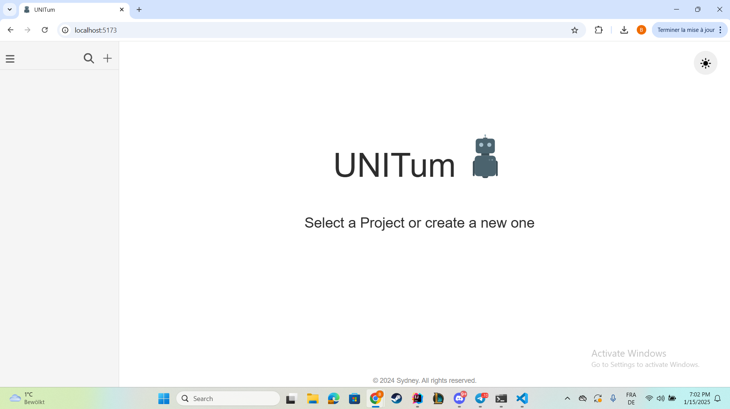
Web application Overview

Slide 9
Agenda
Recap
Milestones
Web Application
AI training
Demo

Slide 10
Overview of AI Training Phase
Models Evaluated:
Llama 2 7B
Code Llama
Falcon
Dataset:
Source: Methods2Test from Hugging Face
Size and Quality: It provides a large, well-annotated dataset from a reliable source
Relevance and Diversity: The dataset aligns with the AI models' tasks and covers a variety of scenarios
Goal: Select the best AI model based on performance on specific tasks

Slide 11
Techniques Used in Training
Low-Rank Adaptation (LoRA):
Focuses only on parameters that need adjustment
Keeps other parameters frozen
Makes fine-tuning more efficient.
Quantization:
Reduces numerical precision in representations.
Saves memory and reduces computational costs.
May lead to minor loss of precision.

Slide 12
Model Comparison
Prompt in Dataset: [INST]<<SYS>>Generate unit tests for the following method or function: public Set<String> getOutputResourceFields( T meta ) { return null; } [/INST]
Expected Response:
@Test public void testGetOutputResourceFields() throws Exception { assertNull(analyzer.getOutputResourceFields(meta)); }
Code Llama Response After Fine-tuning:
Multiple detailed unit tests, handling different scenarios such as null fields, exceptions, and logging.
Includes comprehensive assertions and mock interactions.
Llama 2 Response After Fine-tuning:
A simpler unit test with only a basic assertNull check.
Fewer test scenarios and less detail.

Slide 13
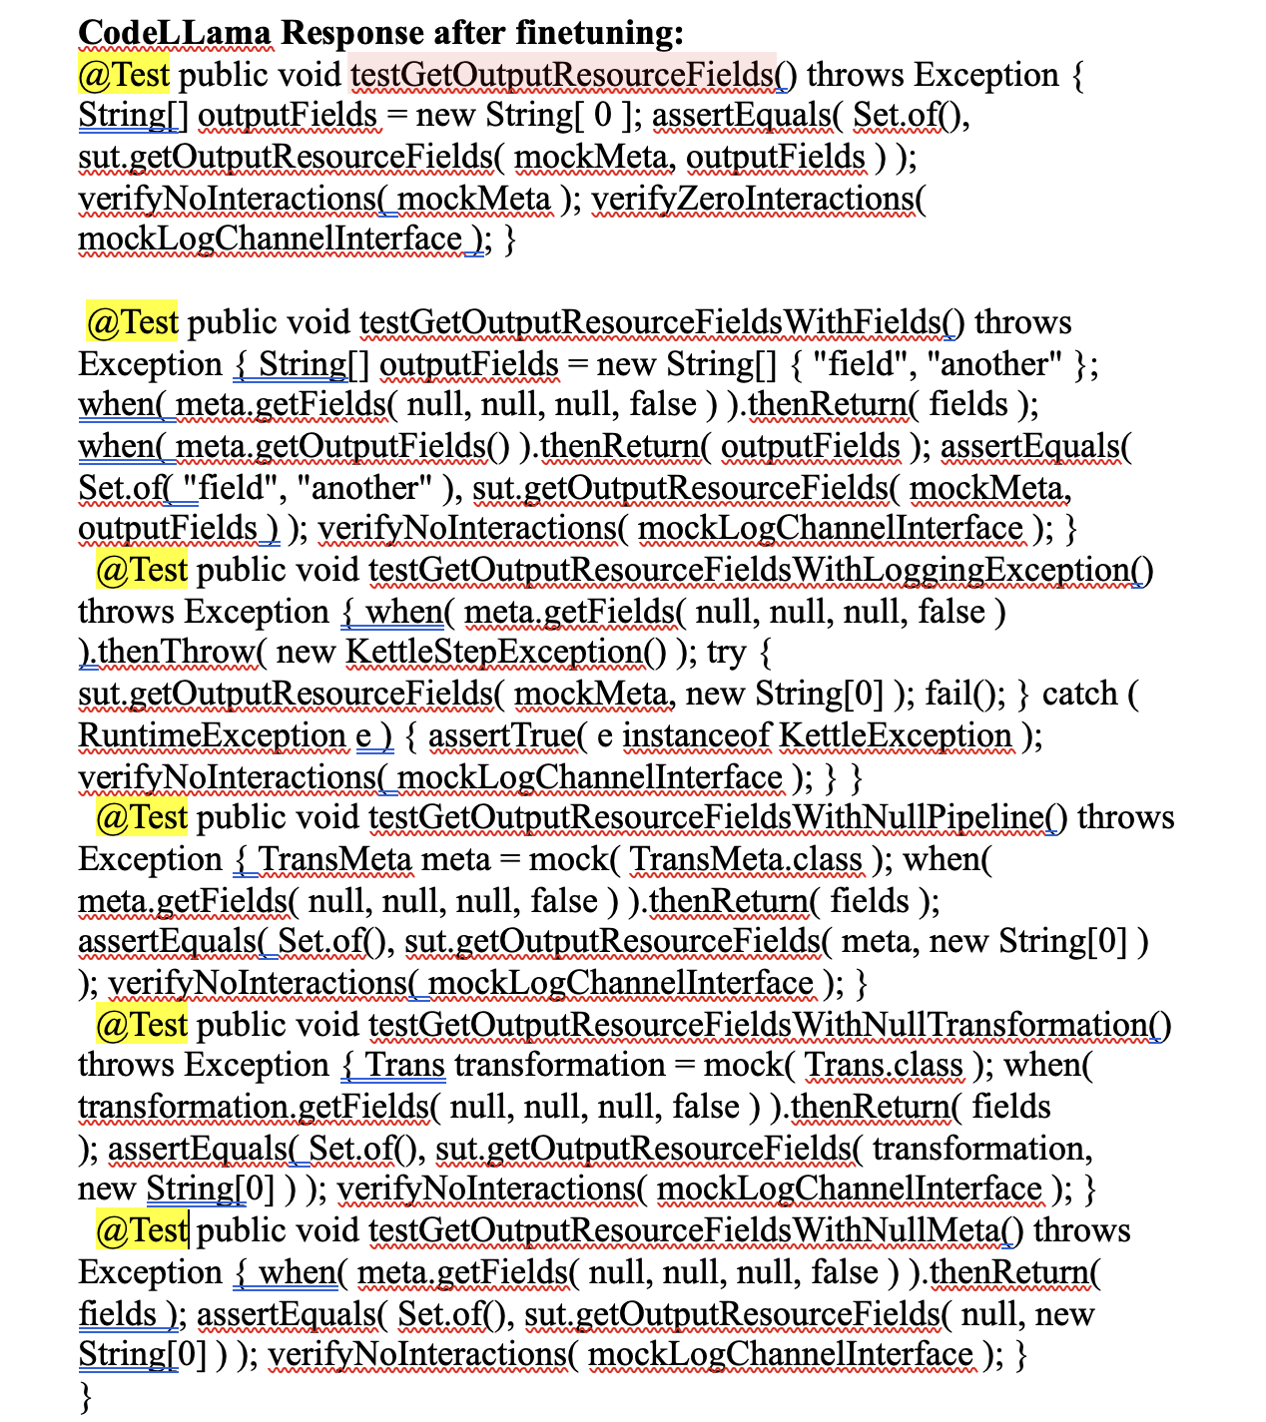
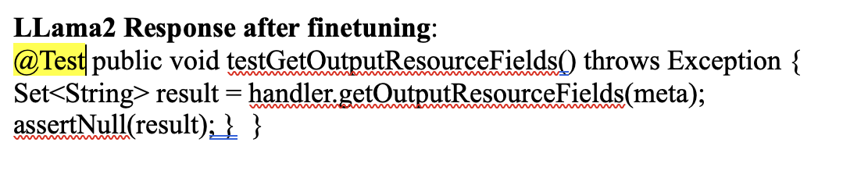
Model Comparison

Slide 14
Model Comparison
Prompt Not in Dataset: [INST]<<SYS>>Generate unit tests for the following method or function: @Override public String toSqlConstraint(String quoteString, DbProduct dbProduct) { ... } [/INST]
Expected Response:
A single unit test focusing on specific constraints for input bounds.
Code Llama Response After Fine-tuning:
Multiple nuanced tests covering various input scenarios (e.g., null upper/lower boundaries, null bounds).
Demonstrates flexibility and thorough testing for edge cases.
Llama 2 Response After Fine-tuning:
Tests handle basic scenarios but lack depth and coverage.
Outputs focus on the correctness of the generated SQL constraint string without additional edge

Slide 15
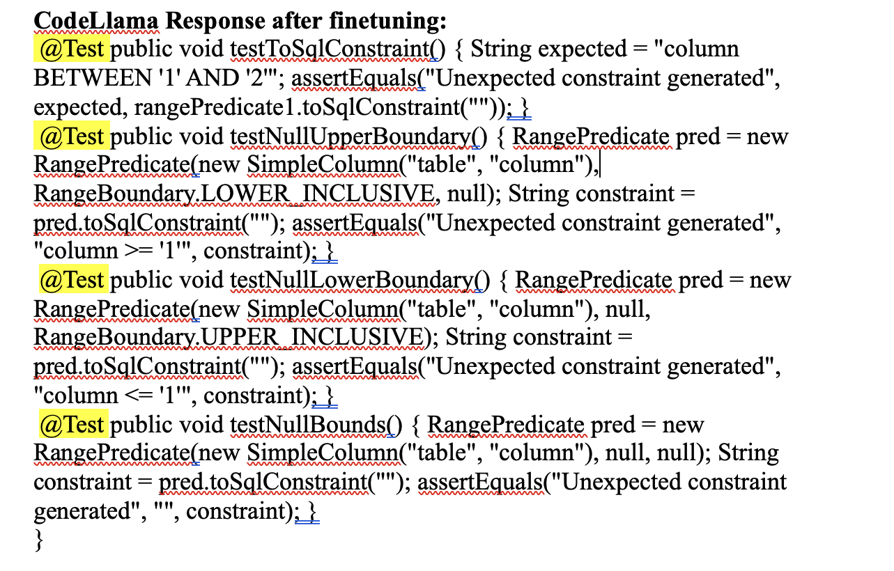
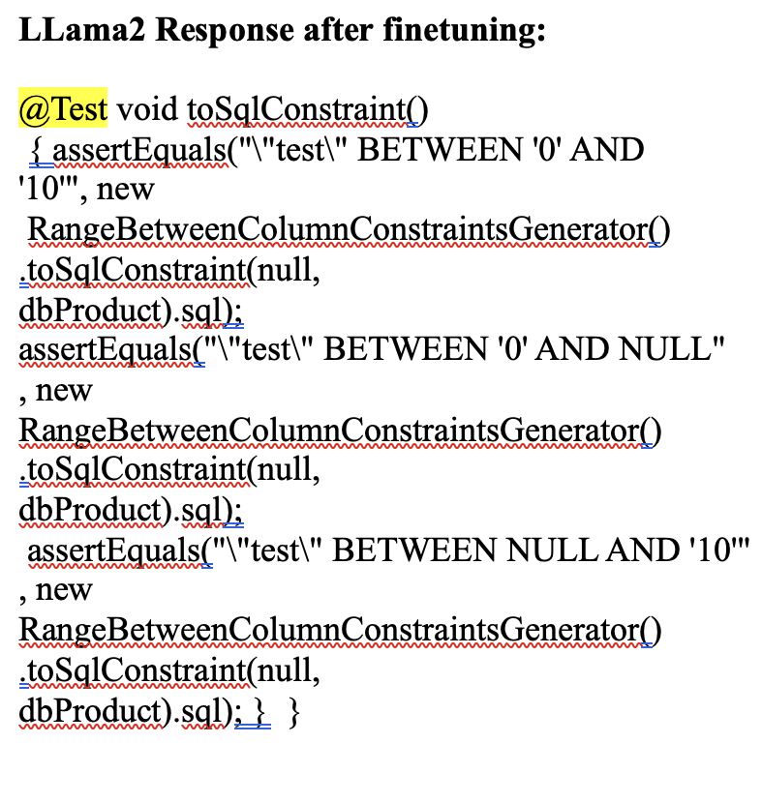
Model Comparison

Slide 16
Agenda
Recap
Milestones
Web Application
AI training
Demo

Slide 17




Summary
In conclusion, our project tackles a critical pain point in software development by automating the generation of unit tests with AI. We are still in the process of choosing the most effective model for this task, and our web application provides a user-friendly interface for developers
Let’s sum it up
SFES???
Looking ahead, we aim to expand the system's capabilities to support more programming languages and improve the accuracy of edge-case handling.

Slide 18


